Slide 1
MEMORY MANAGEMENT in Linux Kernel

Slide 2
Overview
Memory Management in Linux
Comparison of memory management of Window with Linux

Slide 3
I. Memory Management in Linux
Applications
System Libraries (libc)
System Call Interface
I/O Related
Process Related
Modules
File Systems
Scheduler
Networking
Memory Management
Device Drivers
IPC
Architecture-Dependent Code
Hardware
Memory management system provides
  - Management Memory Allocation for all Process
  - Protection
  - Memory Mapping
  - Shared Virtual Memory
Notes:
1. Management Memory
+ Keeps track of the status of each memory location
+ Determines ways to dynamically allocate space of memory among competing processes
+ Updates and reuses the space no longer needed
2. Protection: Almost all versions of UNIX are provided to protect the memory mechanism to ensure no process can overwrite the memory of other processes or the operating system's memory
3. Shared Virtual Memory: Memory management system to control access to the memory space is shared without violating requirements to protect memory
Eg: In the multitasking operating system to share memory space for the process to the operating system can be loaded multiple processes into memory to this process can operate simultaneously
Read more: http://www.tldp.org/LDP/tlk/mm/memory.html
http://www.ukessays.com/essays/engineering/compare-the-memory management.php#ixzz2oSBFItbm

Slide 4
I. Memory Management in Linux
Memory Addressing
Memory Management

Slide 5
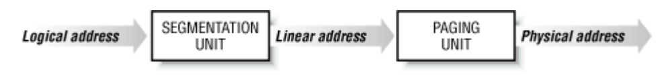
1. Memory Addressing
Logical address
  Generated by the Kernel when excecute programming
  Called as virtual address
  Logical address consists of a segmentand an offset
Linear address
  usually represented in hexadecimal notation. their values range from 0x00000000to 0xffffffff
Physical address
  Address seen by the memory unit

Slide 6
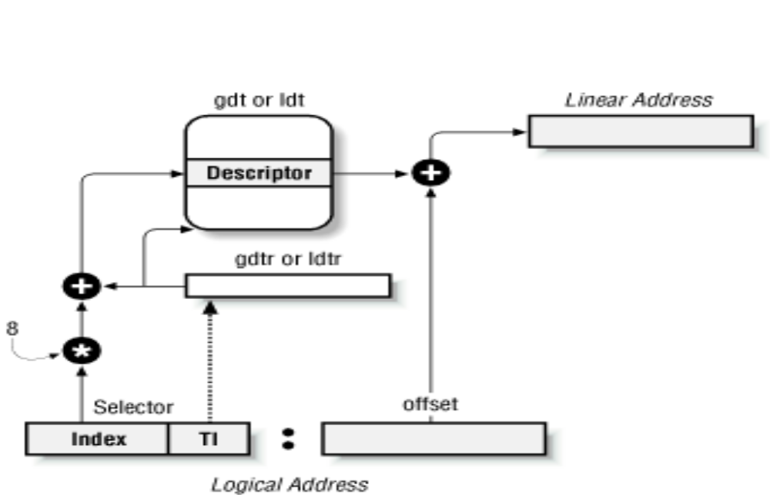
Translating a logical address
Segmentation in Linux
A kernel code segment.
A kernel data segment.
A user code segment shared by all processes in User Mode.
A user data segment shared by all processes in User Mode.
A Task State Segment (TSS) segment for each process.
A default LDT segment that is usually shared by all processes

Slide 7
Page - Frame
Physical address space (physical) of one process can not noncontiguous.
Physical memory is broken into ﬁxed-sized blocks called frames
Logical memory is divided into blocks of the same size called pages
Os always keep track of all the empty frame. When a process is executed, its pages are loaded into any available memory frames
Hardware support for paging consists of a page table that translates logical frames to physical
The page size (like the frame size) is deﬁned by hardware
The size of a page is typically a power of 2 varying between 512 bytes and 16MB bytes per page
Notes:
Why divided Paging?
Paging virtually eliminates the problems of fragmentation
Easily manage multiple tasks: Only loading pages of programming are running, Swap out pages unnecessary

Slide 8
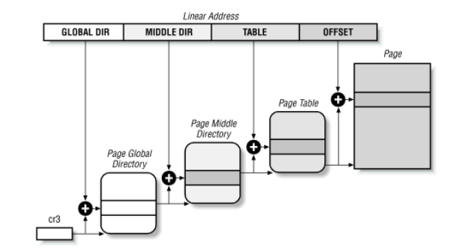
Determination Page - Frame
- The paging unit translates linear addresses into physical ones. It checks the requested access
type against the access rights of the linear address. If the memory access is not valid, it generates a page fault exception
- Contiguous linear addresses within a page are mapped into contiguous physical addresses
- page frames, physical pages (the length of a page frame coincides with that of a page)
-A page frame is a constituent of main memory
-The data structures that map linear to physical addresses are called page tables

Slide 9
Separating memory in Linux
0xFFFFFFFF
Kernel space
mappings
Kernel space
1-GB
0xC0000000
data
text
4-GB
stack
stack
text
3-GB
mappings
user space
data
0x00000000
physical memory
Virtual Memory
Notes:
Protected region memory of system

Slide 10
Memory Management
=> Page Frame Management
Two different page frame sizes is 4KB and 4MB
  The 4 KB size is a multiple of most disk block sizes, so transfers of data between main memory and disks are more efficient -> size as the standard memory allocation unit
Each process needs minimum number of pages using The Buddy System Algorithm
  Reduce memory fragmentation
  Easily management allocate and free memory area
  external fragmentation:
  Contiguous linear addresses (DMA ignores the paging)
  Contiguous phycical addresses
  Organization page-frame is power of 2 (1,2,4,8,16,32,..page):
    + allocate: page-frame continuous (eg: need 12 pages : allocate 16 pages )
    + free : join page-frame into page-frame larger (eg: 1-3 pages -> 4 pages)
Notes:
Cr3 is control register

Slide 11
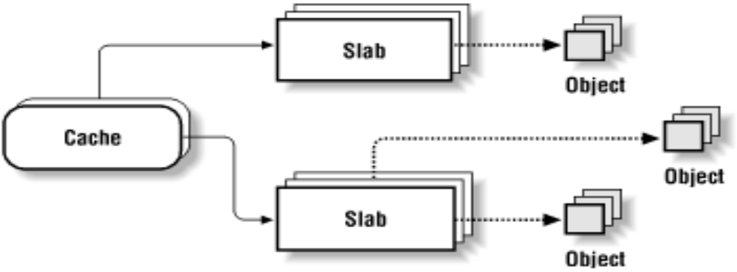
Memory Area Management
The Slab Allocator: The technique is used to retain allocated memory that contains a data object of a certain type for reuse upon subsequent allocations of objects of the same type
Eliminating Internal fragmentation
Reduce the number of calls to the buddy system allocator.
Increasing the average memory access time

Slide 12
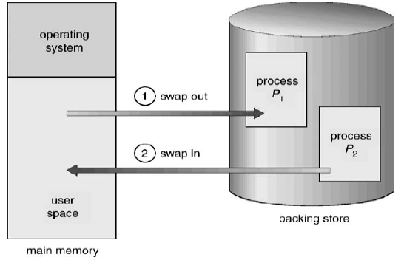
Swapping
Swapping : It is a technique in which processes are swapped in or out of main memory to the disk (swap in/ swap out)
  Memory savings: Free pages rarely used or unnecessary
  Speeds accessible and processing are reduced
Notes:
Eg: Swapping
There are some important pages are used by one application during startup, which can only be used for initialization only, then never use it again -> swap out to disk or cache disk
Paging :
It carries out the transfer and pages data back into physical memory when they are needed again.
- Least Recently Used

Slide 13
II.Memory Management in Windows and Linux
Memory divided into blocks (Page, Frame) and using mapping memory
Demand-paged virtual memory: 32 or 64-bits;Copy-on-write, Shared memory, Memory mapped files
Window
Linux
1.Data structures
Windows uses tree data structure
Each node of the tree is called Virtual Address
It uses linked list data structure
It maintains a list of vm_area_structs
Linux uses data structure depending upon the situation.
2.Distribution of Process Address Space
The upper 2GB is kept for windows kernel mode,
The lower 2GB of the address space is reserved for
user mode
Address structure Paging: Page number, Page offset
3GB of memory space is reserved for user mode, 1GB is kept for Kernel mode
Address structure Paging: Global Directory, Middle Directory, Page Table, Offset
3.Page replacement
First in First out Page Replacement Algorithm (F.I.F.O.)
The oldest page is chosen for replacement and
It has low performance
It has maximum number of page faults
Least Recently Used Page Replacement Algorithm (L.R.U.)
The page that is not used for a long period of time is
selected as victim page and is replaced
Notes:
If number of entries becomes more than 32, Linux converts linked list into a tree.
3.Page replacement of LINUX
Implemented in two ways- Counters and stack.
In counters, each page table entry is associated with a time-of-use field. The page with smallest time value is replaced.
In stack, the page at the bottom is removed and put on the top of the stack. Least recently used is always at the bottom of the stack.
4. FIFO
Thuật toán FIFO là thuật toán đơn giản và dễ cài đặt nhất. Với thuật toán này thì trang mà hệ điều hành chọn để swap out là trang được đưa vào bộ nhớ sớm nhất, hay ở trong bộ nhớ lâu nhất
5. LRU
Theo thuật toán này thì trang được hệ điều hành chọn để thay thế là trang có khoảng thời gian từ lúc nó được truy xuất gần đây nhất đến thời điểm hiện tại là dài nhất, so với các trang đang ở trên bộ nhớ chính. Như vậy trong trường hợp này hệ điều hành phải ghi nhận thời điểm cuối cùng trang được truy xuất
Read more: http://www.ukessays.com/essays/engineering/compare-the-memory-management.php#ixzz2oSZKKL36

Slide 14

http://www.ukessays.com/essays/engineering/compare-the-memory-management.php#ixzz2oSZKKL36
http://www.cs.uic.edu/~jbell/CourseNotes/OperatingSystems/9_VirtualMemory.html
http://www.tldp.org/LDP/tlk/mm/memory.html
http://www.tldp.org/LDP/khg/HyperNews/get/memory/linuxmm.html
http://wikipedia
Etc…

